Slide 1
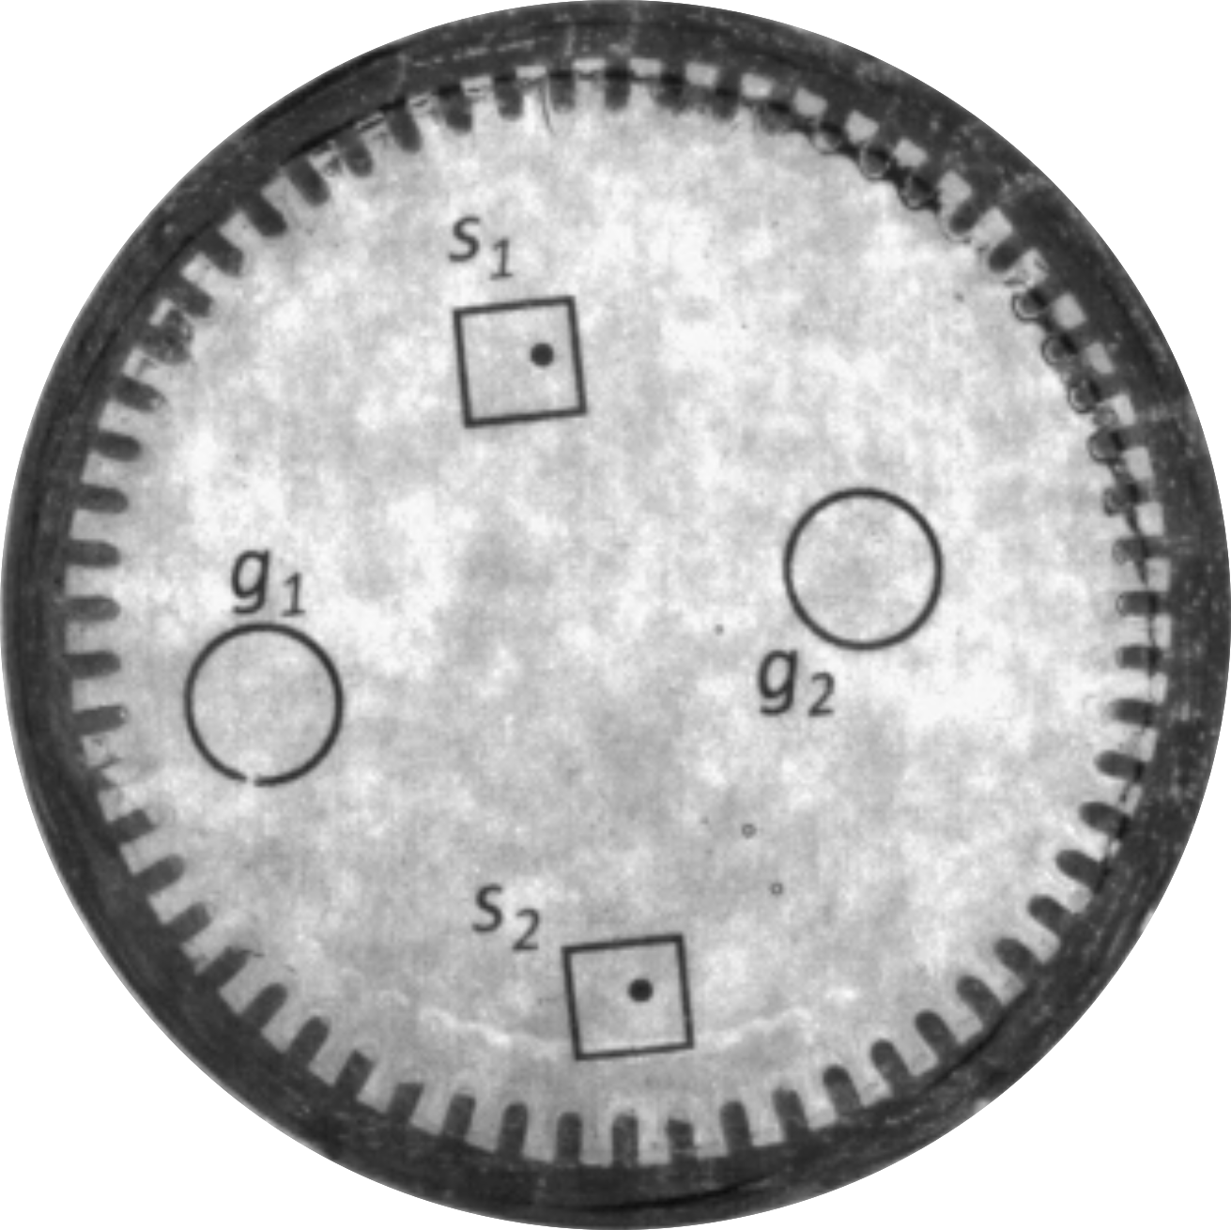
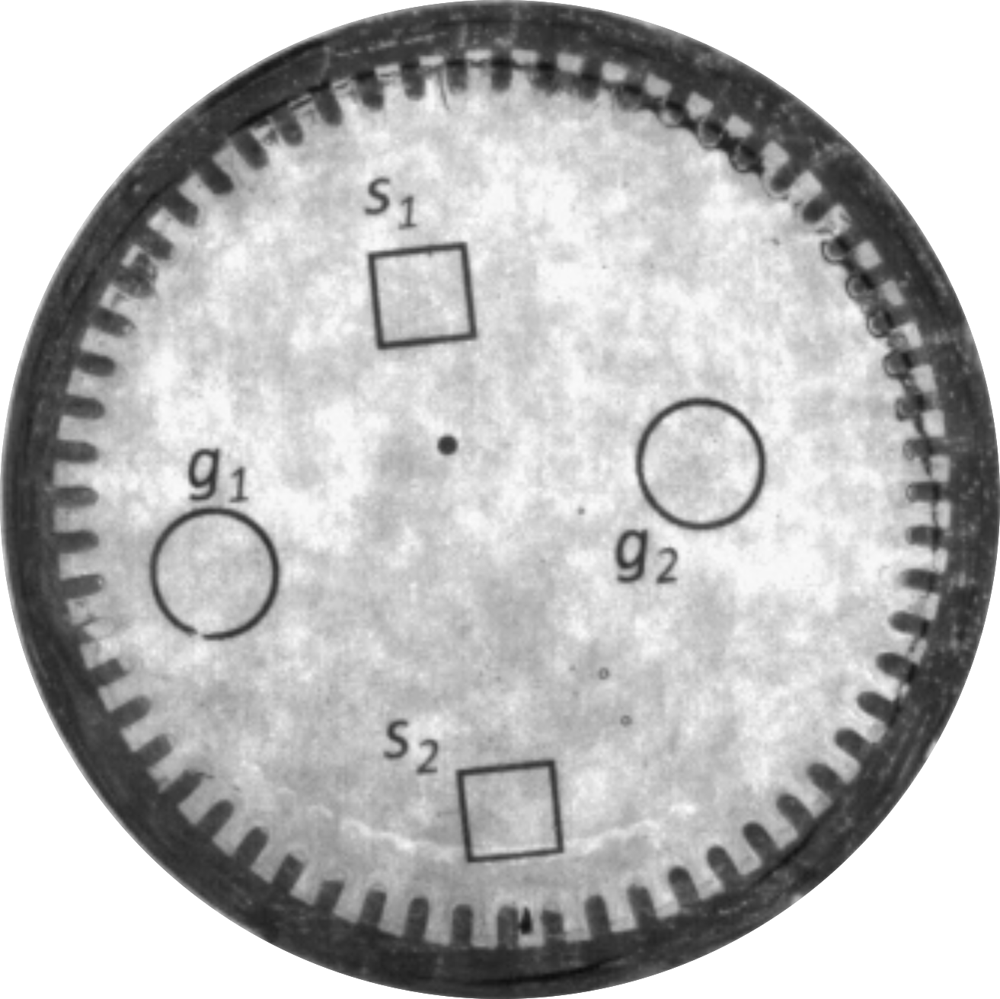



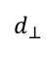
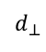
control input
5 mm
5 mm
5 mm
5 mm
5 mm
$$d_{⊥}$$
1 mm magnets
Reachable
Set
$$d_{⊥}$$
Reachable
Set
m₁
m₂
m₃
m₄
final

